Slide 1
Improve Query Performance with Intelligent Query Processing in SQL Server 2022
Edward Pollack
Data Architect
Transfinder

Slide 2
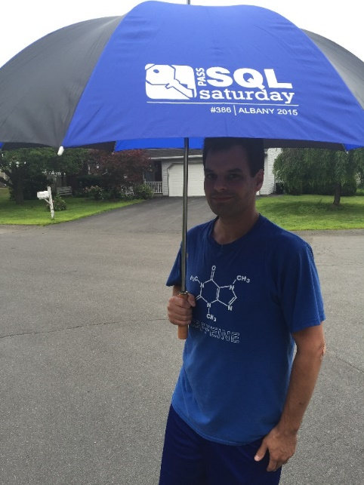



Ed Pollack
Microsoft Data Platform MVP
Published author of:
Dynamic SQL: Applications, Performance, and Security, 2nd Edition
Published author of Analytics Optimization with Columnstore Indexes in SQL Server
Published in Expert T-SQL Functions in SQL Server, 3rd Edition
Expert T-SQL Indexing in SQL Server, 4th Edition
Author on SQLServerCentral, SQLShack, and SimpleTalk.
Organizes:
SQL Saturday New York City
Future Data Driven
Capital Area SQL Server User Group
Speaker at many data events Twitter: @EdwardPollack

Slide 3








SQL Saturday New York City 2023
A BIG Thank You to our Sponsors
Platinum
Gold
Bronze

Slide 4
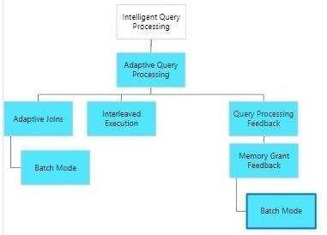
IQP in SQL Server 2017

Slide 5
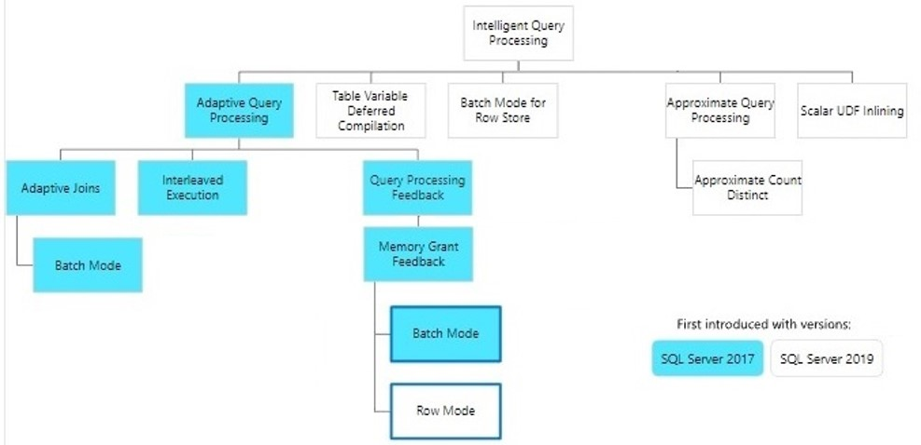
IQP in SQL Server 2019

Slide 6
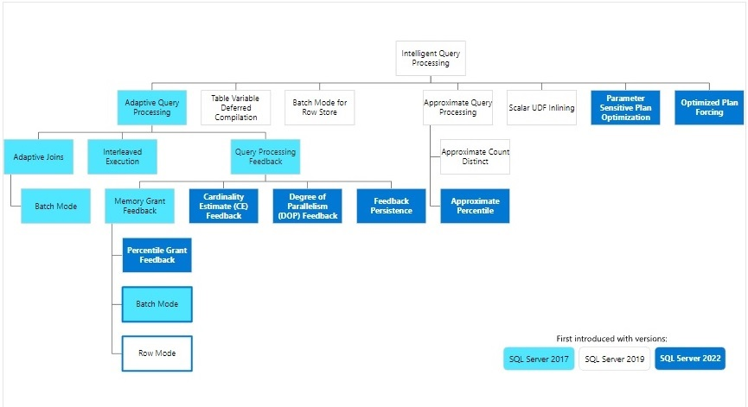
IQP in SQL Server 2022

Slide 7
The Problem (Pre-IQP)
The Query Optimizer must create execution plans FAST.
Relies on statistics, metadata, and query details to create plans.
Execution plans were static structures.
Execution plans must be complete before runtime.
Problems: parameter sniffing, bad plans, incorrect cardinality, parallelism, joins, etc…
Larger data + more complex queries = bigger problems.
Cached query plans = cached problems ☺

Slide 8
The Solution: Intelligent Query Processing
Suite of features that makes query processing more dynamic.
Execution plans can contain decision-points based on runtime data.
Suboptimal plans can be identified and improved.
Faster queries with no code changes*!
Compatibility level must be set to use IQP features
Query Store is required/recommended for some IQP features
*Bad code is still bad code and always will be ☺

Slide 9
A Note on Versions
This presentation is based on SQL Server 2022.
If on an older version, check the giant graphic (and/or docs) to determine what IQP it has.

Slide 10
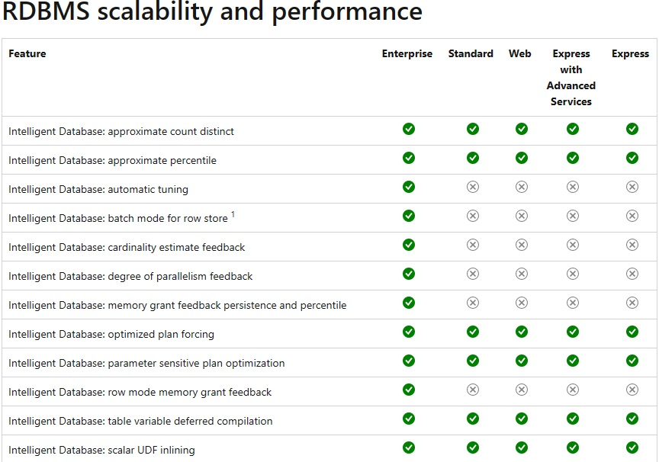
A Note on Editions

Slide 11
Demo
Compatibility Levels &
Enabling/Disabling Features

Slide 12
Adaptive Query Processing
Allows execution plans to defer decisions until runtime to improve performance.
Ideal when:
Query inputs change often.
Cardinalities vary with each execution.
Performance is inconsistent.
The top execution plans have similar costs

Slide 13
Adaptive Joins (Batch Mode)
Allows SQL Server to choose between hash and nested loops joins.
Decision is deferred until after the first input is scanned at runtime.
Defines threshold for when to switch to nested loops.
Useful when input sizes change often (high vs. low cardinality)
Requires compatibility level 140 (SQL Server 2017).

Slide 14
Demo
Adaptive Joins

Slide 15
Interleaved Execution
Allows for cardinality feedback from multi-statement table valued functions (MSTVF). Previously, MSTVFs have fixed estimates.
Estimate = 100 for 2014/2016. Estimate = 1 in earlier versions.
If actual rows returned by the MSTVF vary greatly from estimated rows, then the downstream execution plan subtree is re-evaluated.
More downstream operators + larger cardinality gap = more effective.
Only applies to read-only MSTVF referencing statements that are not used in a CROSS APPLY.
MSTVF are still black boxes (but smarter ones).
Requires compatibility level 140 (SQL Server 2017). Can be enabled/disabled as a database-scoped configuration.

Slide 16
Notes on Feedback Persistence
Stores IQP decisions alongside performance data in the Query Store.
Allows query plan optimizations to outlive the plan cache (in the Query Store).
Plan regressions are quickly identified and discarded.
Requires Query Store!

Slide 17
Memory Grant Feedback
Automatically adjust memory grants based on previous executions:
If operations spill to disk, then increase memory grant for future executions.
If operations allocate 50% or more excess memory, reduce the memory grant.
Enabled for batch mode in SQL Server 2017.
Enabled for row mode in SQL Server 2019.
SQL Server 2022 provides percentile and persistence mode memory grant feedback. Requires Query Store.
Persistence stores memory grant info in the Query Store so that it outlives the cache.
Percentile-based calculations provide more accurate grants for unstable workloads.

Slide 18
Cardinality Estimation Feedback
Evaluates cardinality estimation (CE) model-related assumptions.
If estimated vs. actual row counts for an operator are significantly different, then:
When the same query is executed again, a new query plan is tested that adjusts the CE model.
If plan quality improves, then the new plan replaces the old one.
Plan regressions are discarded, including user cancellations.
Requires Query Store
Requires compatibility level 160 (SQL Server 2022)

Slide 19
Degree of Parallelism Feedback
Queries self-adjust DOP if performance is suboptimal.
Uses query duration and waits to determine DOP inefficiency.
Measures time spent on parallelism operators and compares to other operators.
If the overhead for parallelism is deemed too high, then DOP is reduced.
Auto-adjusted DOP honors server & query hint MAXDOP.
Is off by default and must be enabled. (DOP_FEEDBACK database-scoped configuration setting)
Requires compatibility level 160 (SQL Server 2022)
Requires Query Store

Slide 20
Table Variable Deferred Compilation
Table variable row count is measured prior to compilation.
Actual row count is used to determine dependent plan operators.
No more one row cardinality assumptions!
Compilation/recompilation frequency is unchanged.
This is how temporary tables already manage cardinality.
Requires compatibility level 150 (SQL Server 2019).

Slide 21
Demo
Table Variable Deferred Compilation

Slide 22
Batch Mode on Rowstore
Extends batch mode to work on heaps and B-trees.
Query operators process batches of rows instead of one-at-a-time.
Benefits analytic-style queries on larger data sets on rowstore.
Is automatically used when deemed beneficial.
Requires compatibility level 150 (SQL Server 2019).

Slide 23
Demo
Batch Mode on Rowstore

Slide 24
Approximate Query Processing
Aka: New functions for distinct counts & median calculations
Allows for estimates for expensive sort-based operations.
APPROX_COUNT_DISTINCT
Guarantees 2% error rate within a 97% probability.
Added in SQL Server 2019
APPROX_PERCENTILE_CONT & APPROX_PERCENTILE_DISC
Guarantees 1.33% error rate within a 99% probability.
Added in SQL Server 2022
For use-cases where 100% precision is unnecessary
Dashboards, visualization, estimates, etc…

Slide 25
Demo
Approximate Query Processing

Slide 26
Scalar User-Defined Function Inlining
Scalar user-defined functions are substituted into calling queries.
Removes the scalar UDF operator from the execution plan.
Improves performance by:
Replacing iterative UDF operators with set-based ones.
Allowing costs to be effectively applied to materialized UDF code.
Reducing the number of statements compiled as part of a query using a UDF.
Allowing for parallelism in queries that use UDFs.
Requires compatibility level 150 (SQL Server 2019).

Slide 27
Parameter Sensitive Plan Optimization
Identifies queries parameter sensitive queries at-risk for parameter sniffing.
Creates query variants based on at-risk cardinality ranges.
The dispatcher plan contains the logic as to which variants to use.
Reconsiders execution plans for each query variant.
Query store not required, but is recommended for research purposes.
Requires compatibility level 160 (SQL Server 2022).
https://learn.microsoft.com/en-us/sql/relational-databases/performance/parameter-sensitivity-plan-optimization

Slide 28
Optimized Plan Forcing
Addresses compilation time in repeatedly forced queries/plans.
Creates optimization replay script to speed up Optimization.
Only applies to plans with FULL optimization.
Distributed queries and those with RECOMPILE are not eligible.
Requires Query Store
Requires compatibility level 160 (SQL Server 2022)

Slide 29
Detailed Monitoring of IQP Actions
Extended events exist for many IQP features.
For example, DOP includes the following extended events:
Dop_feedback_eligible_query
Dop_feedback_provided
Dop_feedback_validation
Dop_feedback_stabilized
Dop_feedback_reverted
Dop_feedback_analysis_stopped

Slide 30
Conclusion
IQP offers a wide range of features that improve query performance!
Most are on by default, but some require enabling or explicit use (DOP Feedback, approximate query processing functions).
IQP is a compelling reason to upgrade to SQL Server 2022.
These features solve many query-tuning challenges that have persisted for years in SQL Server (and other database platforms).

Slide 31
Thank You!
Edward Pollack
@EdwardPollack
ed@edwardpollack.com
Ed Pollack | LinkedIn

